Slide 1
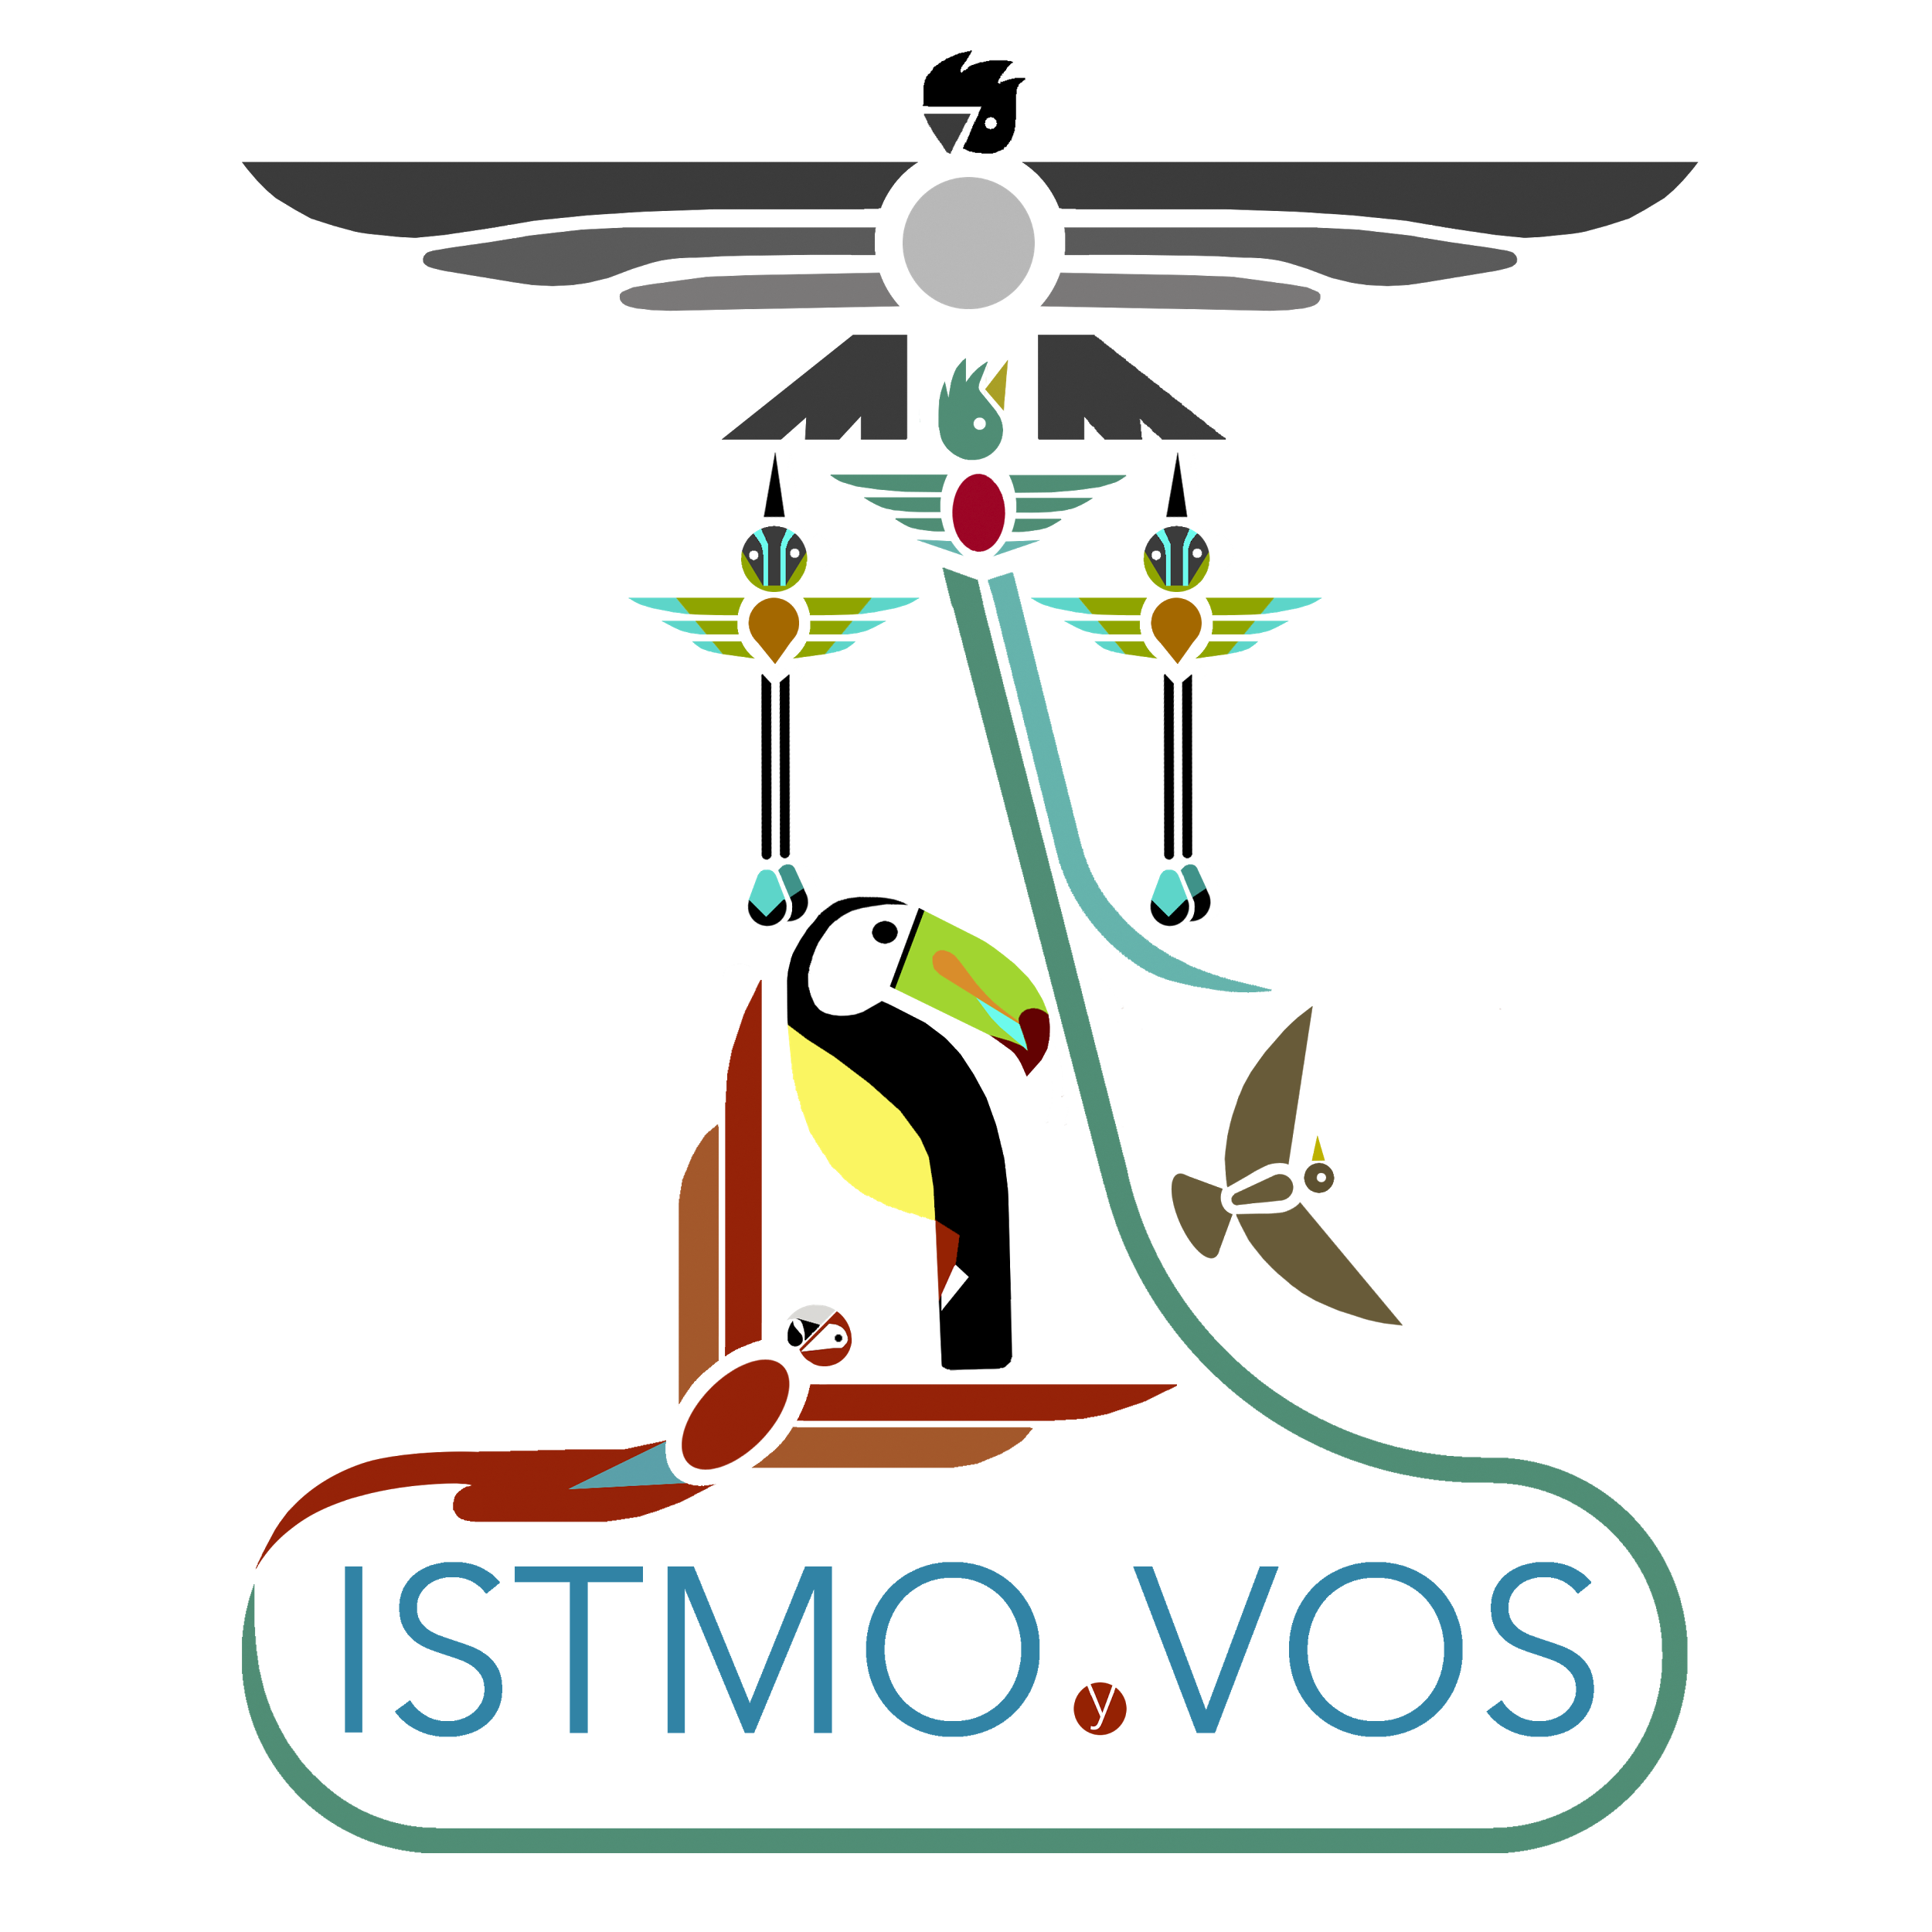
Guatemala
Featuring
Ixcanul
A film portraying the
Indigenous people of Guatemala
Film. Series

Slide 2
41%
Of the population of Guatemala is indigenous

Slide 3
First of its kind
First film ever featuring Kaqchikel [Cah-chee-KELL] language of the Mayan family
First film that has a cast almost entirely of indigenous actors
First film that portrays indigenous culture as it is and not as foreign

Slide 5
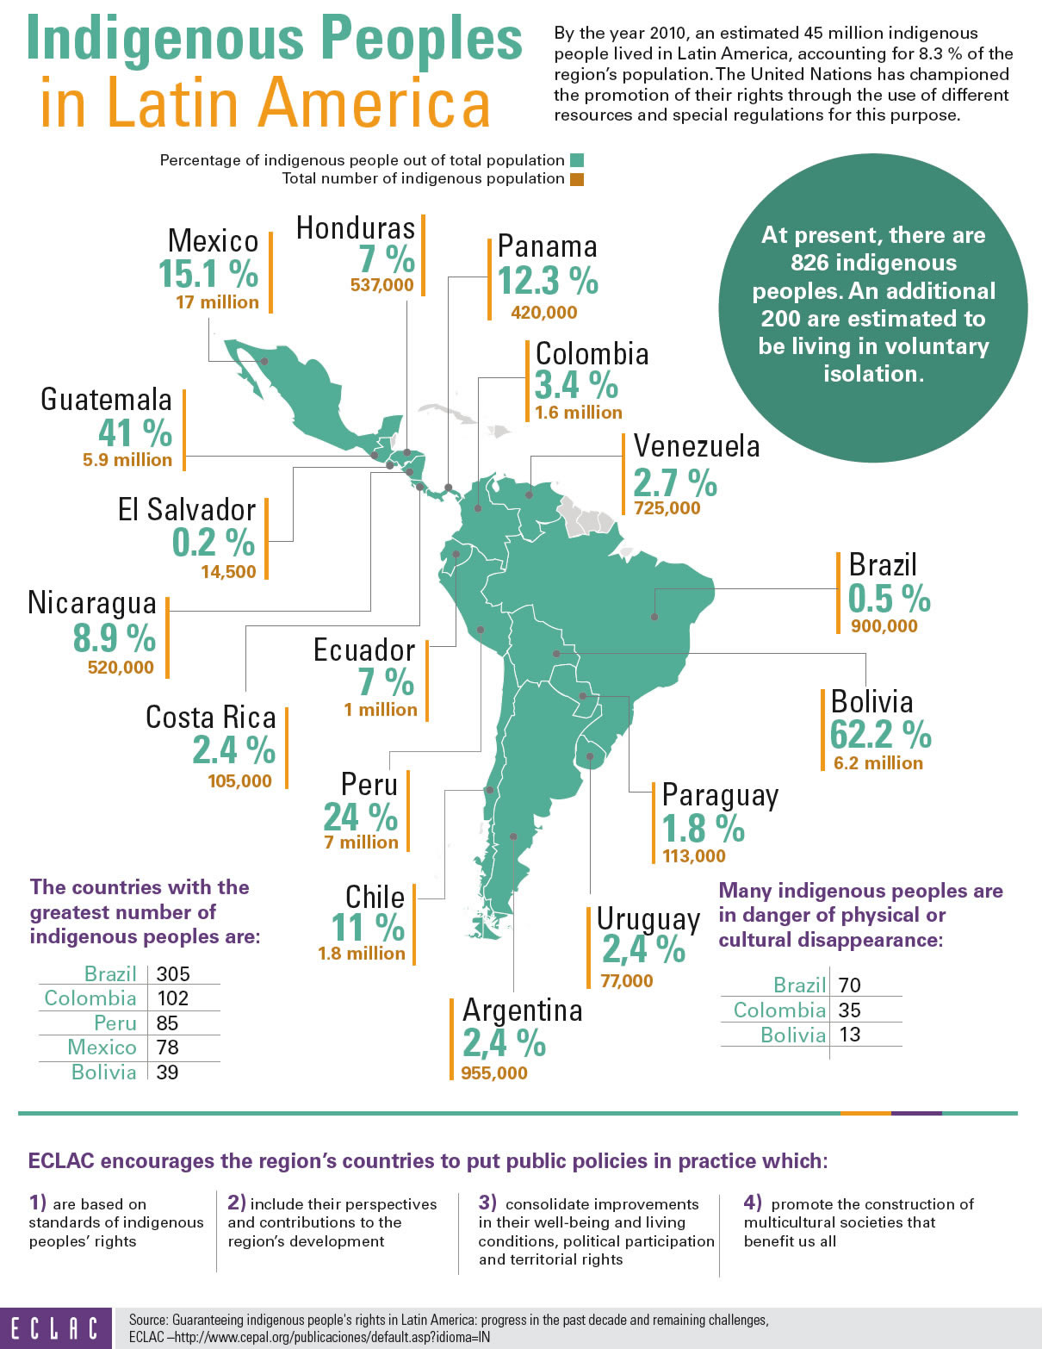
Largest indigenous population of Central America, and largest percentage in one country

Slide 6
Largest indigenous population of Central America, and largest percentage in one country
Second largest presence of indigenous people in a single country in all Latin America

Slide 7
Largest indigenous population of Central America, and largest percentage in one country
Second largest presence of indigenous people in a single country in all Latin America
Fourth largest total population in one country in Latin America

Slide 8
60% 40%
Of Guatemalans speak Spanish
Of Guatemalans speak Amerindian languages
AKA
The 23 indigenous languages

